Slide 1
Lecture 17 - Covariance and Correlation
DS 4400: Machine Learning and Data Mining 1

Slide 2
Today
Today
Big Picture
Covariance
Correlation
Normalized I(X; Y )

Slide 3
Announcements
Deadline for Research Project: December 5th at 11:59 PM EST.
Final test: December 3rd

Slide 4
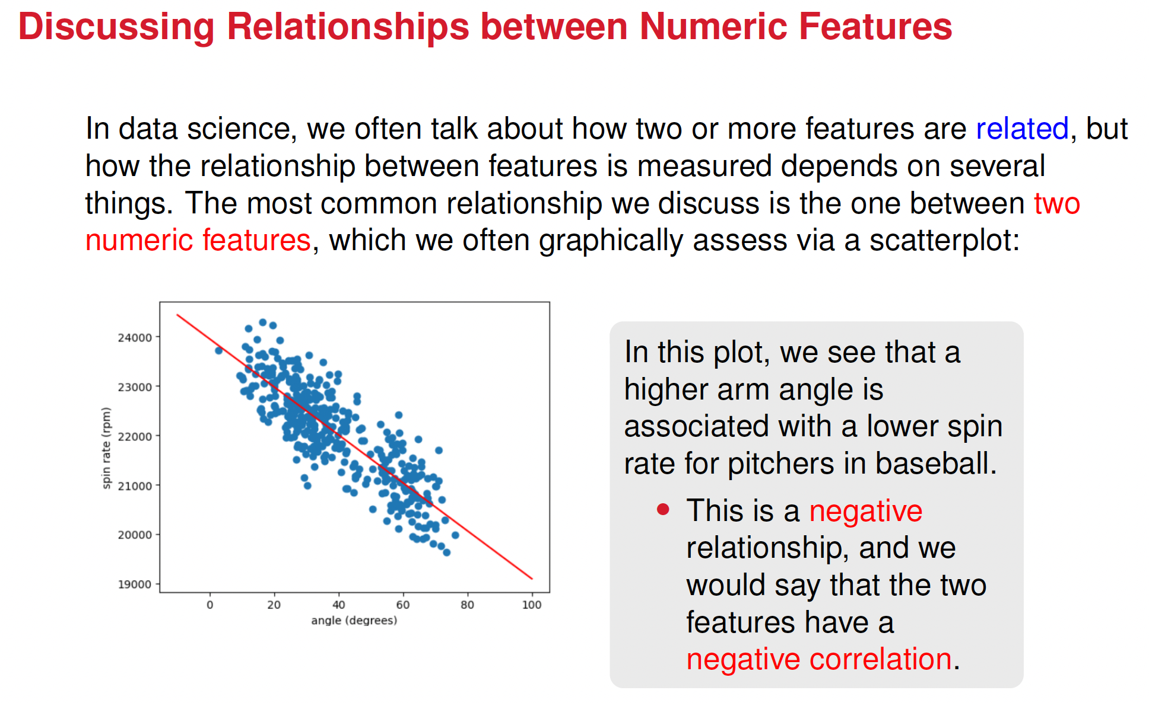

Slide 5
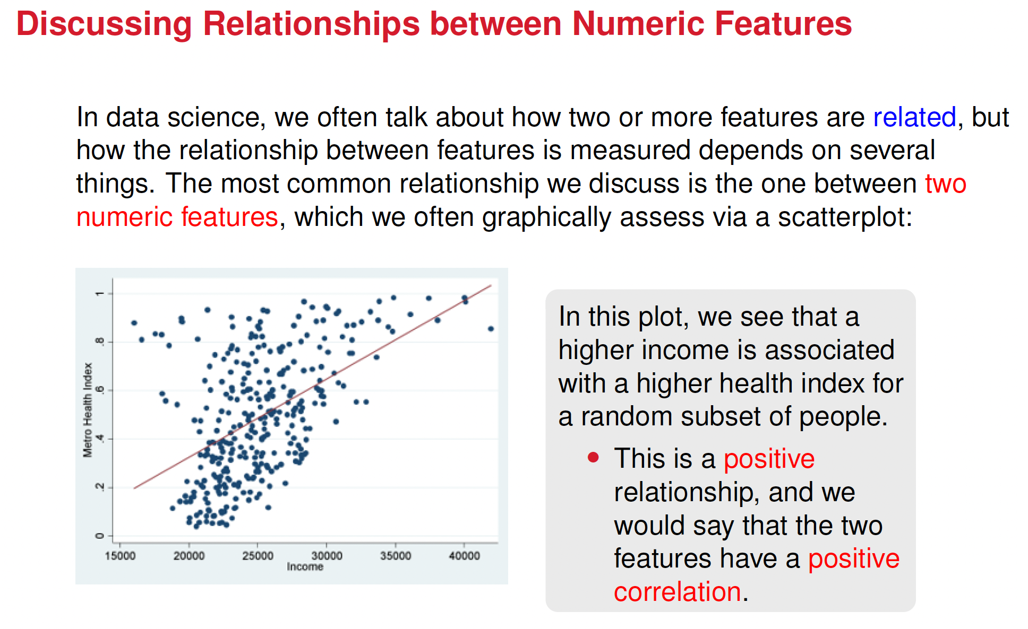

Slide 6
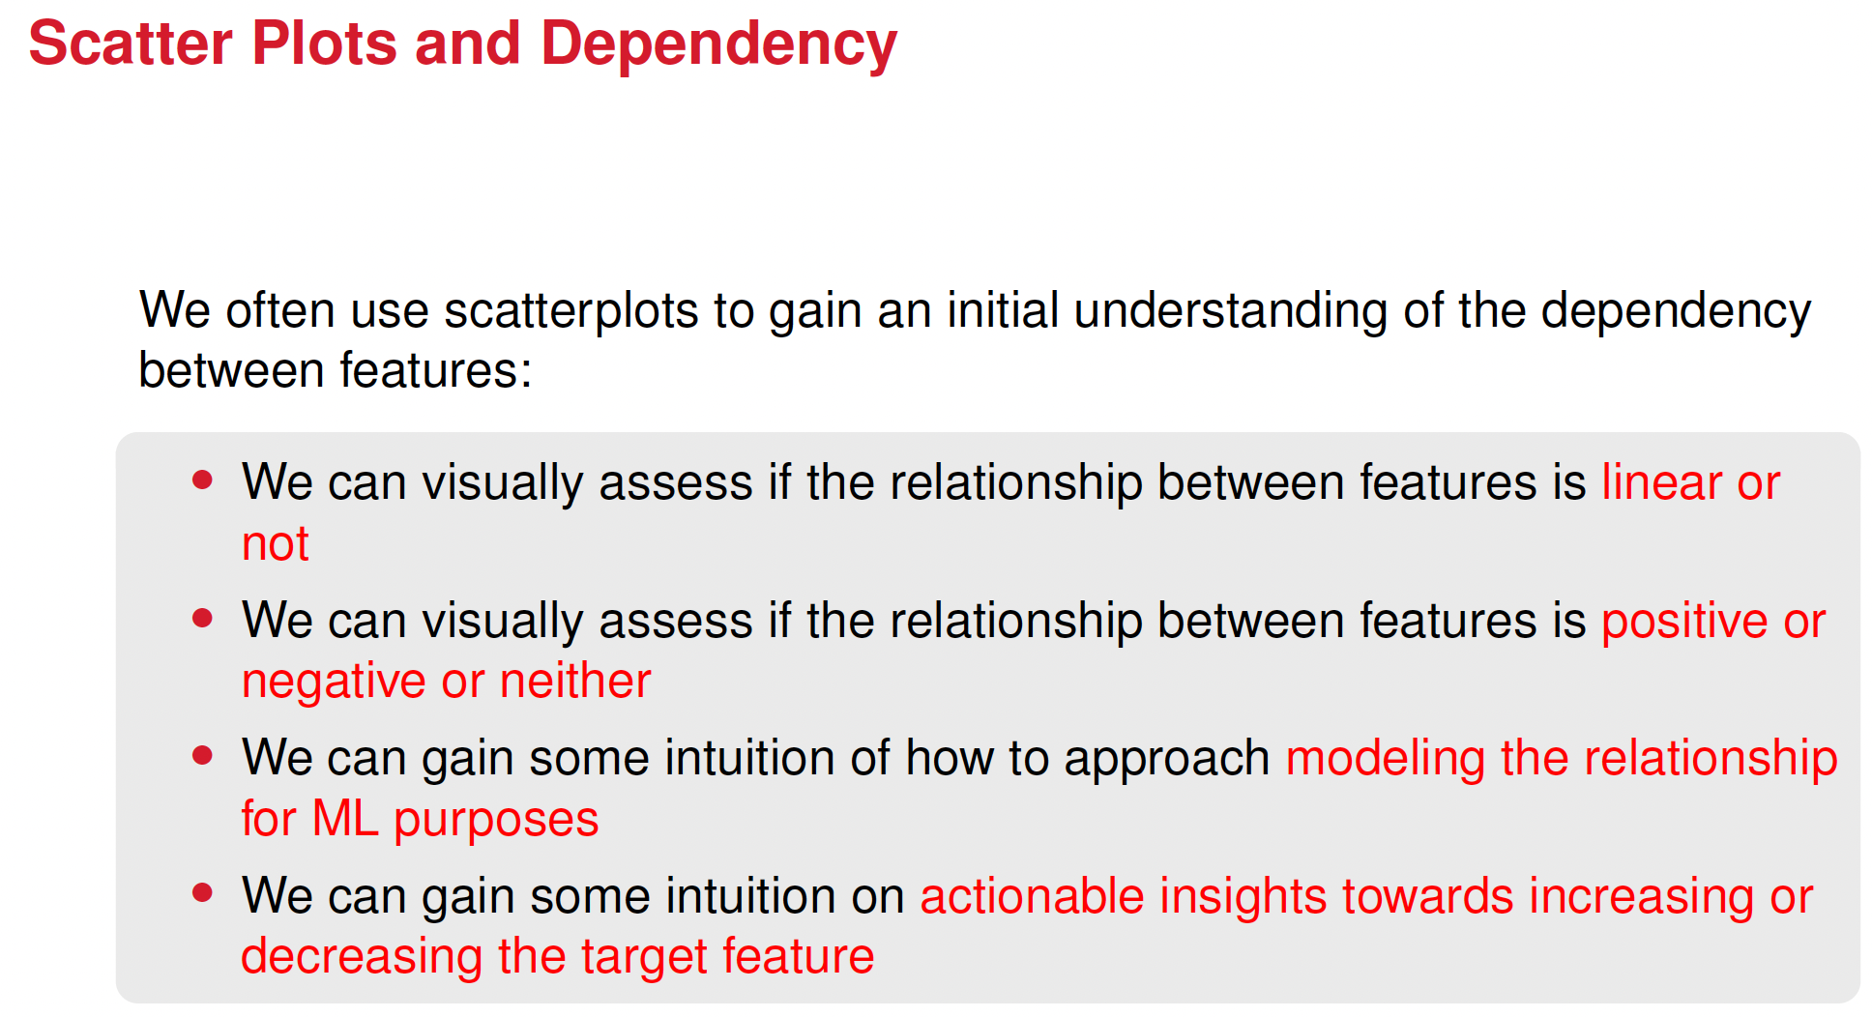

Slide 7
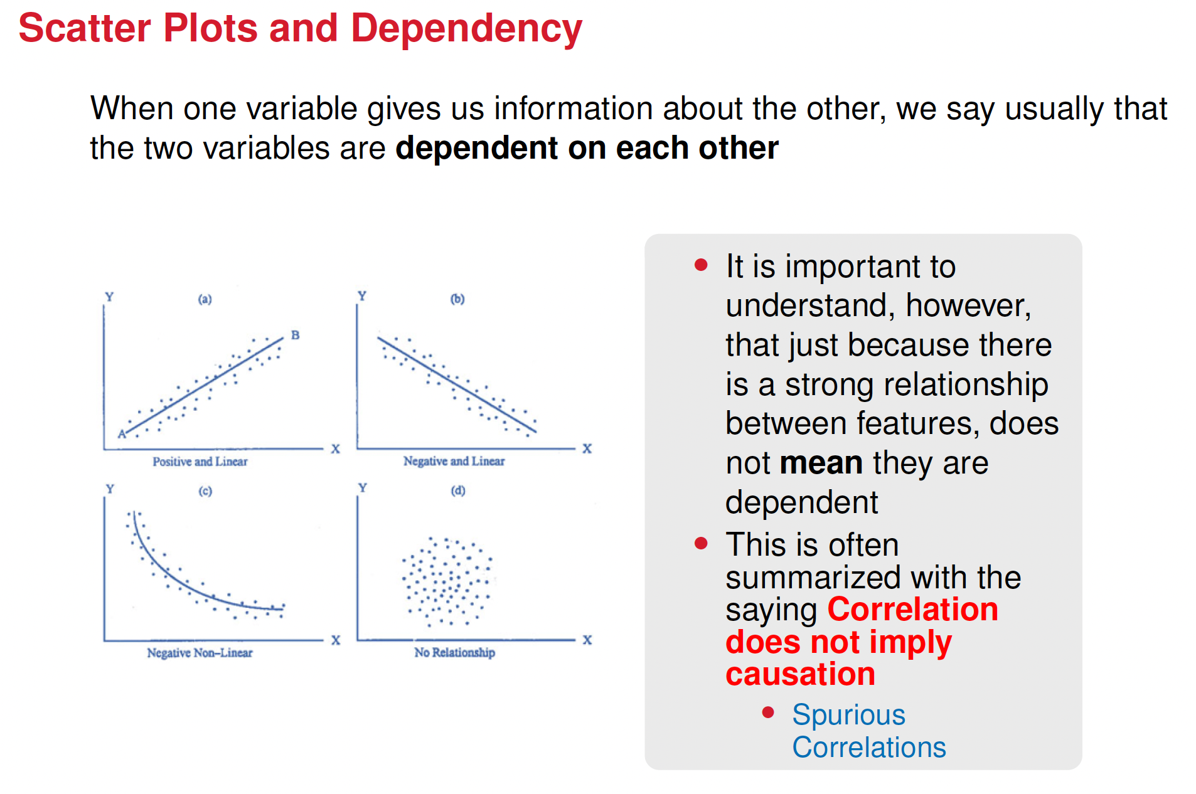

Slide 8
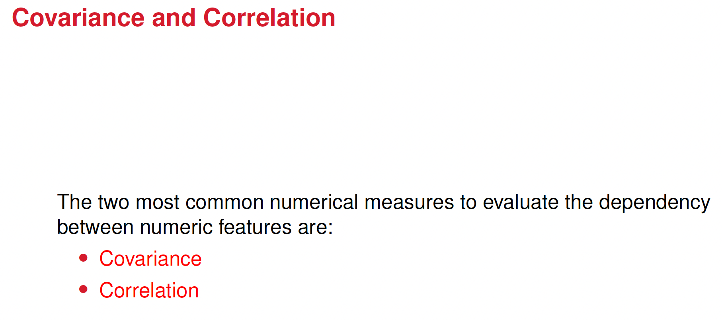

Slide 9
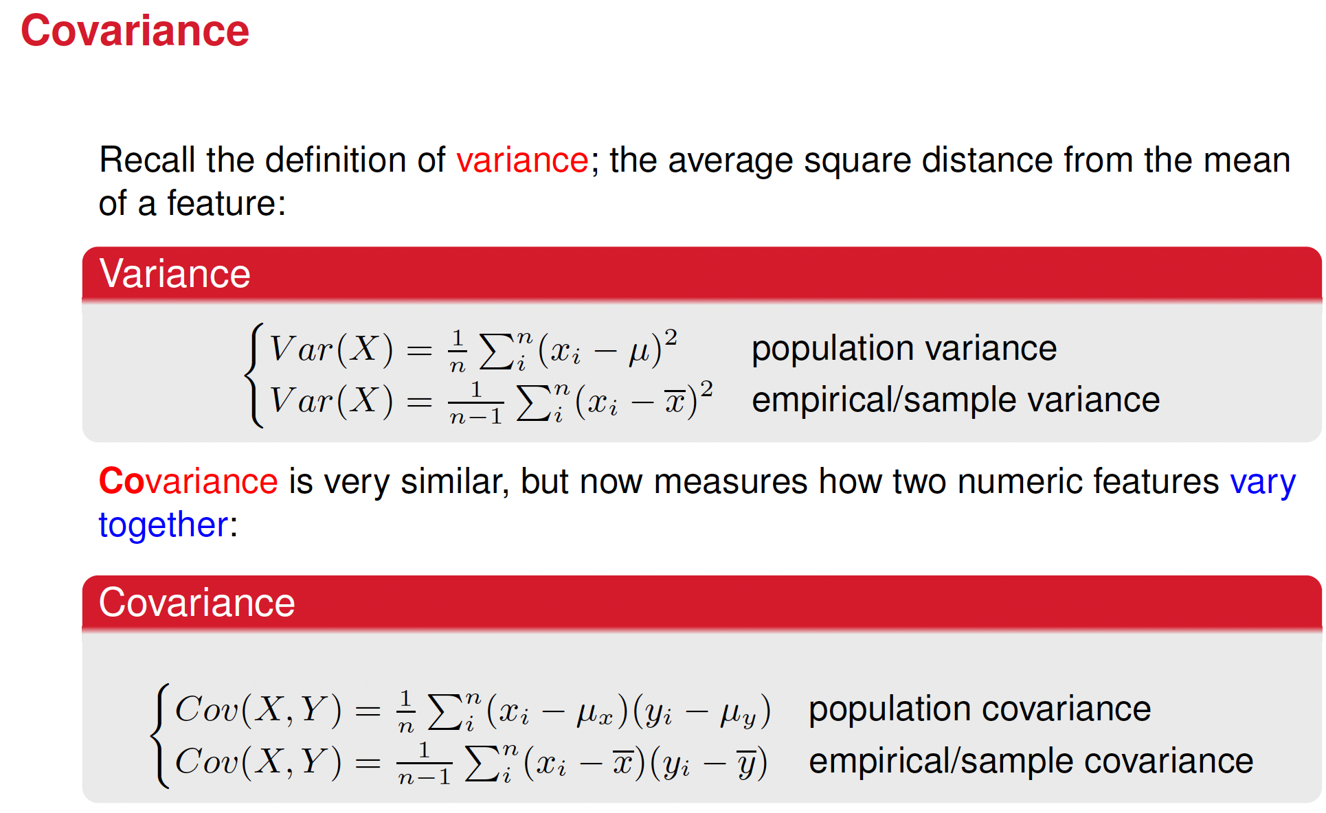


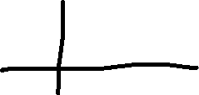



Notes:
Give the intuition of both variance but especially covariance

Slide 10
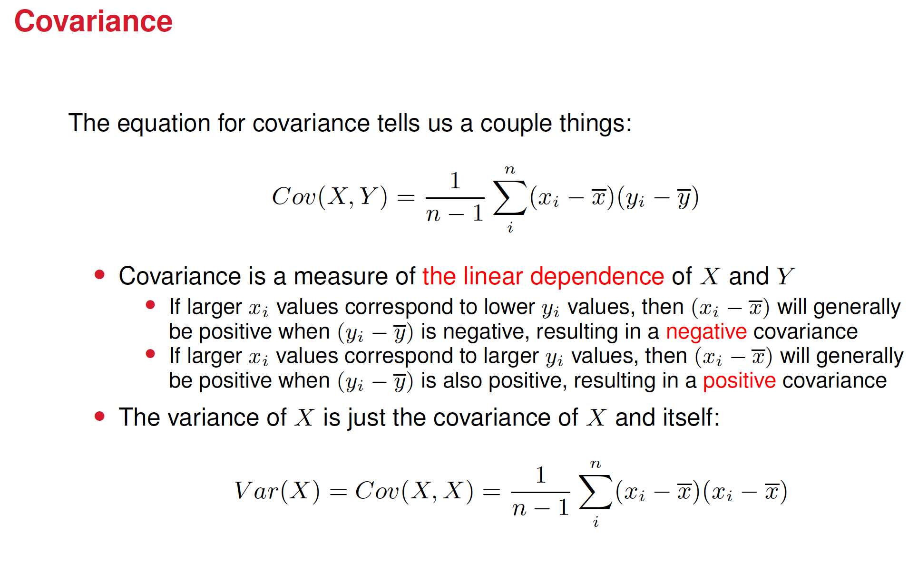

Slide 11
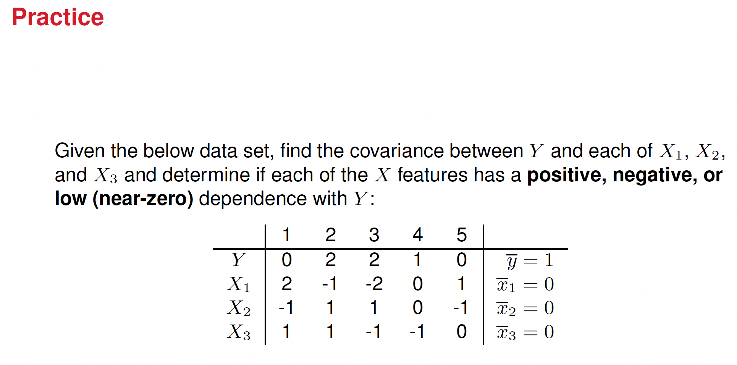

Slide 12





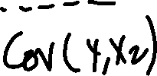


































Solution

Slide 13
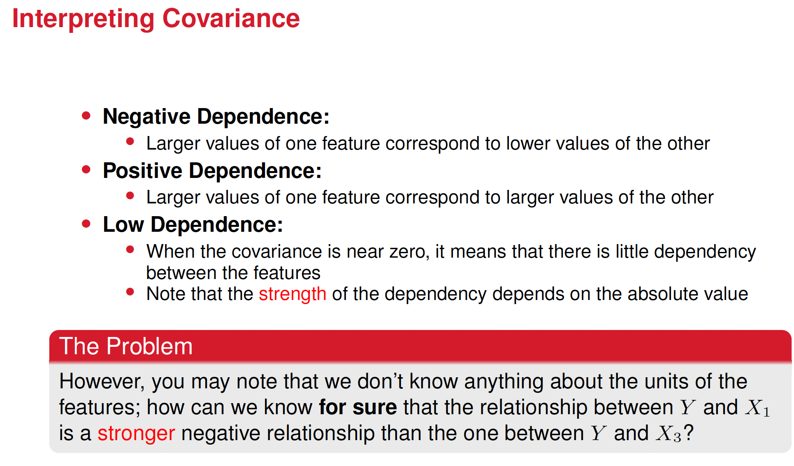

Slide 14
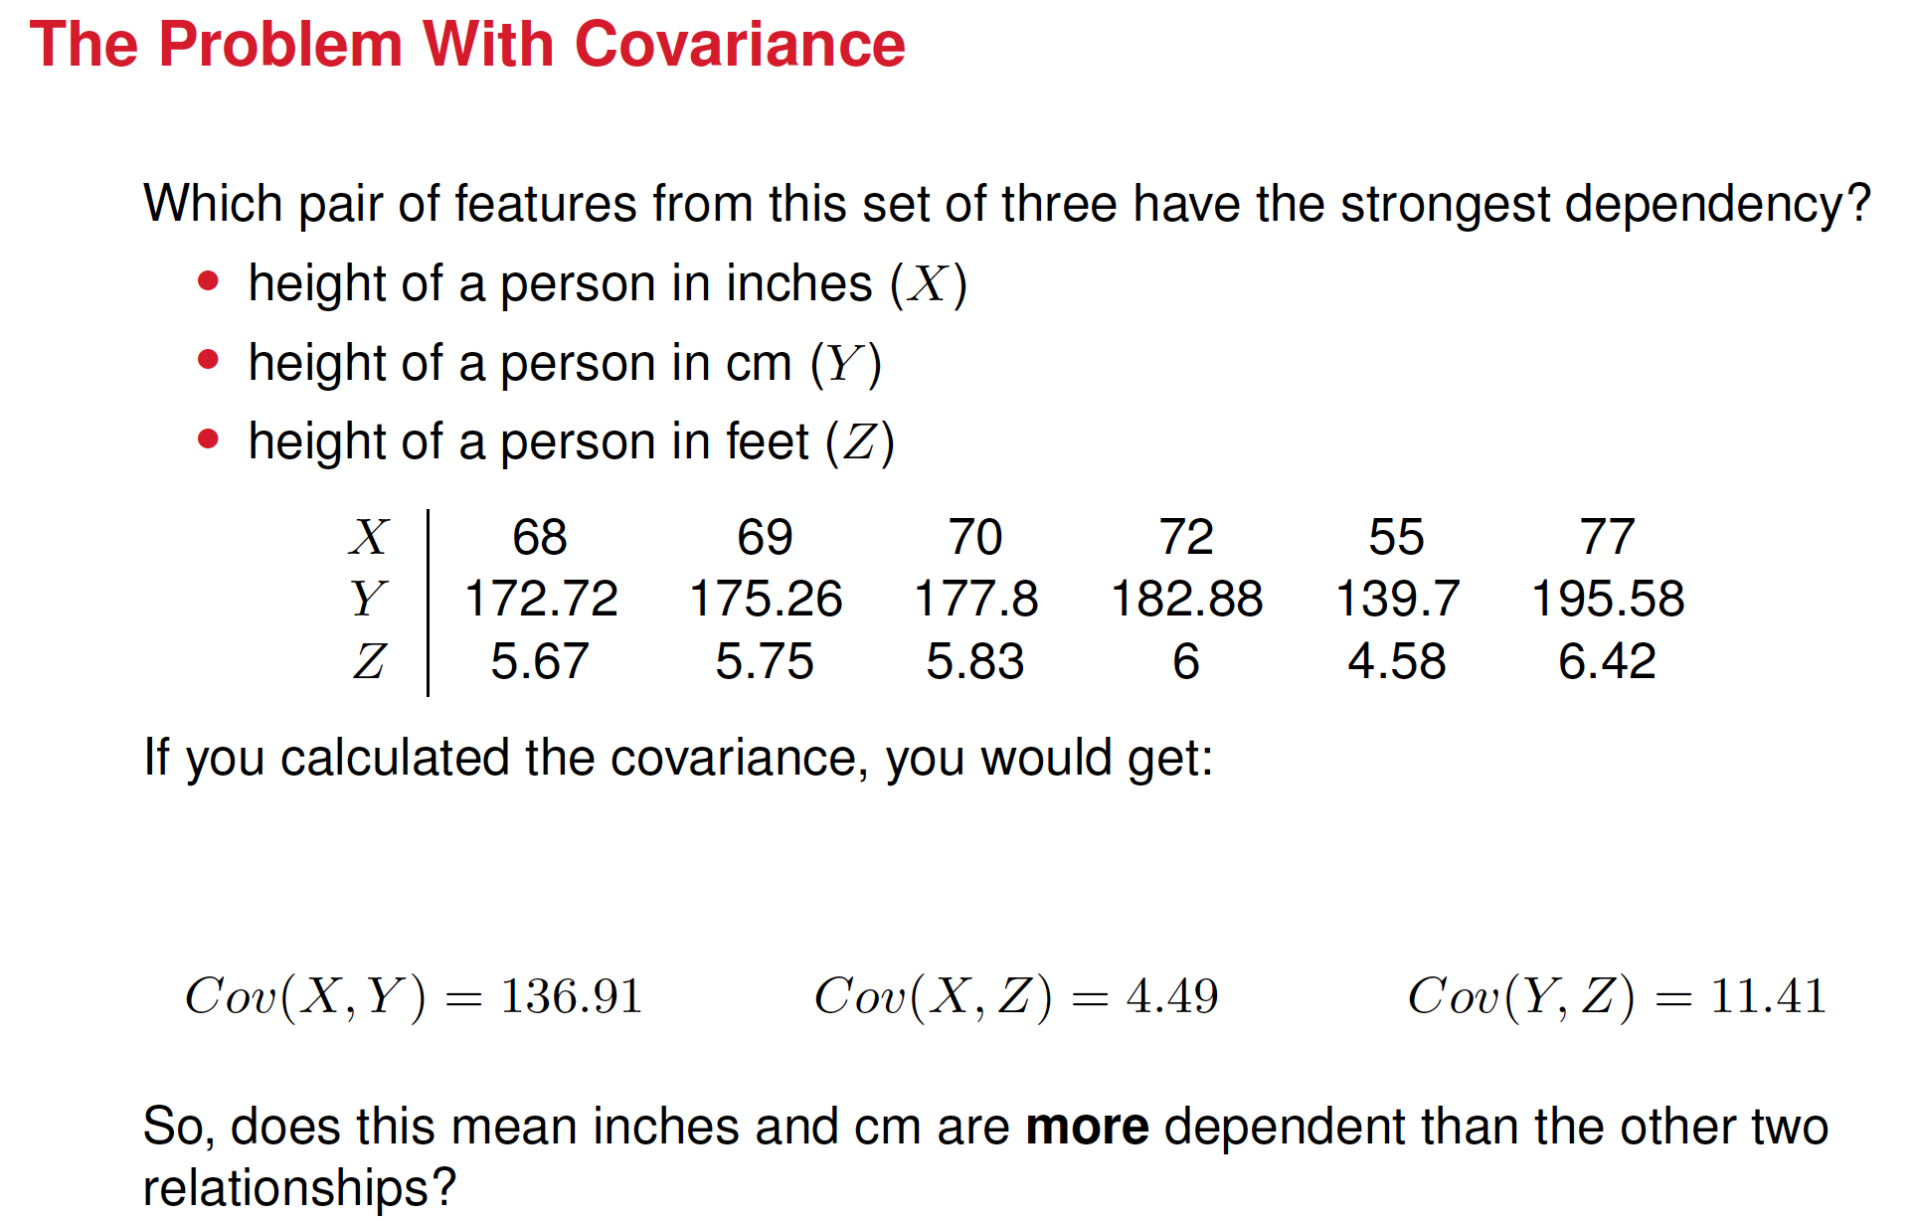

Slide 15
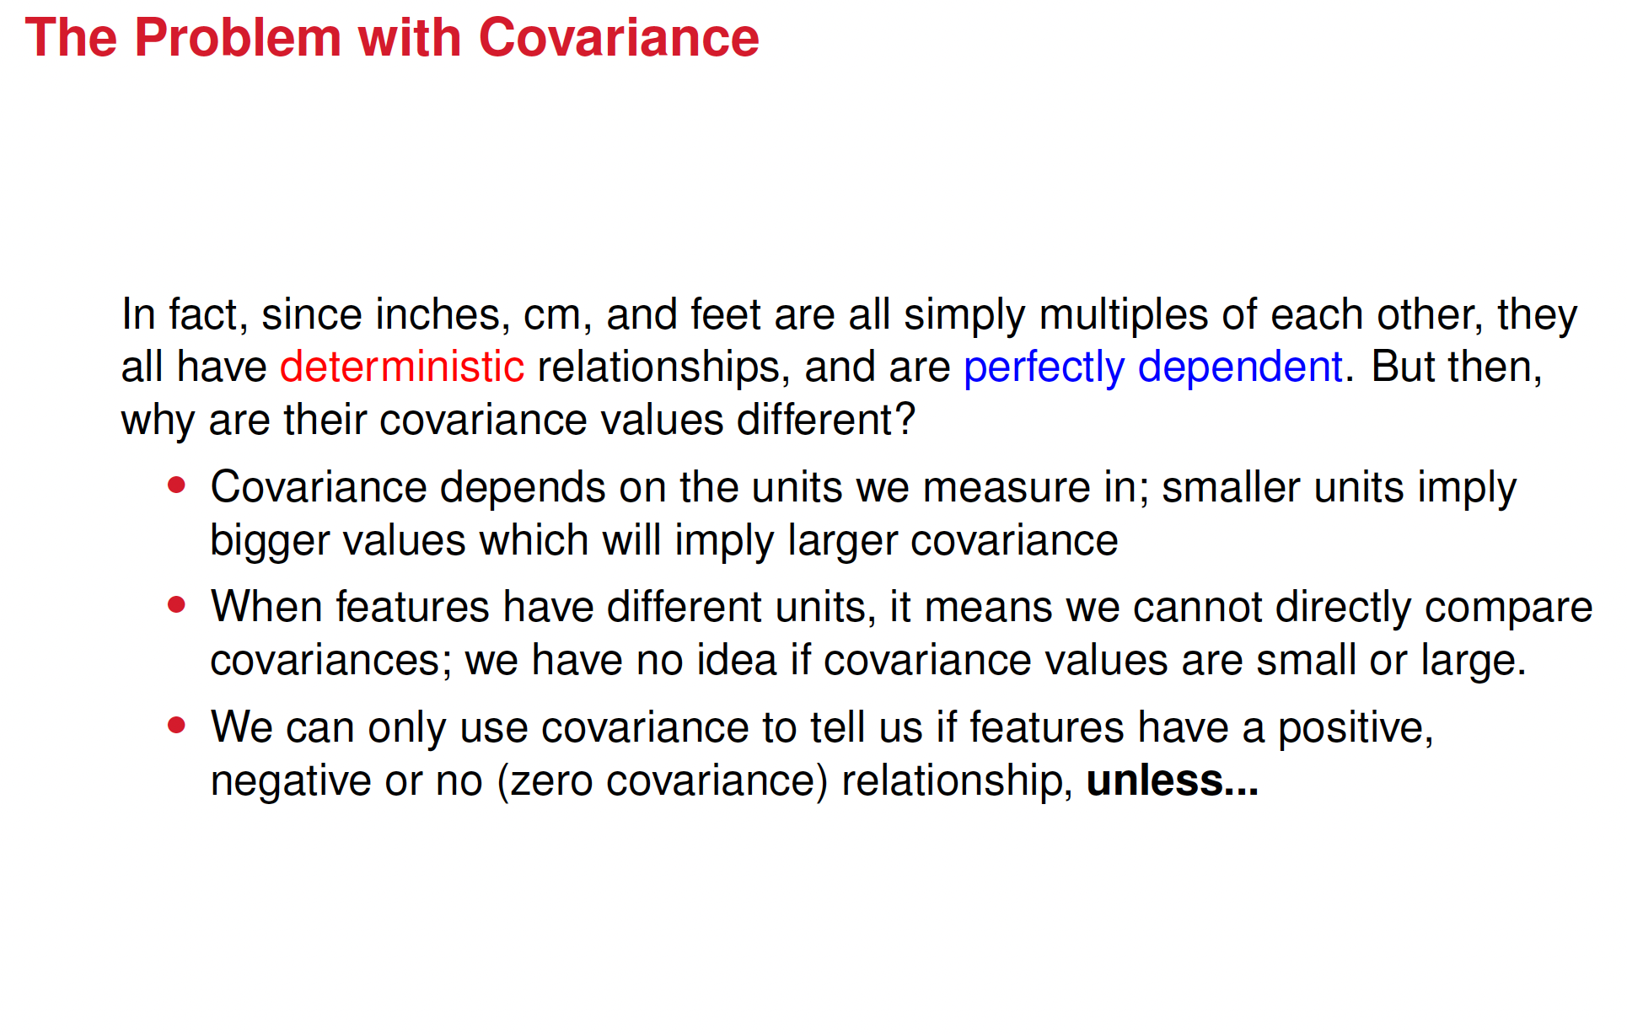

f you measure height in meters and get a covariance of 0.02, converting to centimeters would multiply the covariance by 100²=10,000, giving a new covariance of 200.

Slide 16
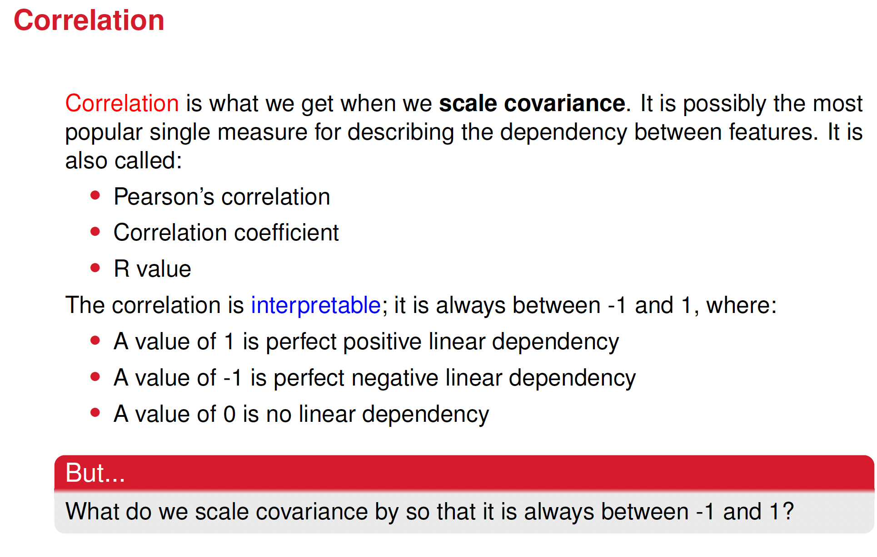




Slide 17
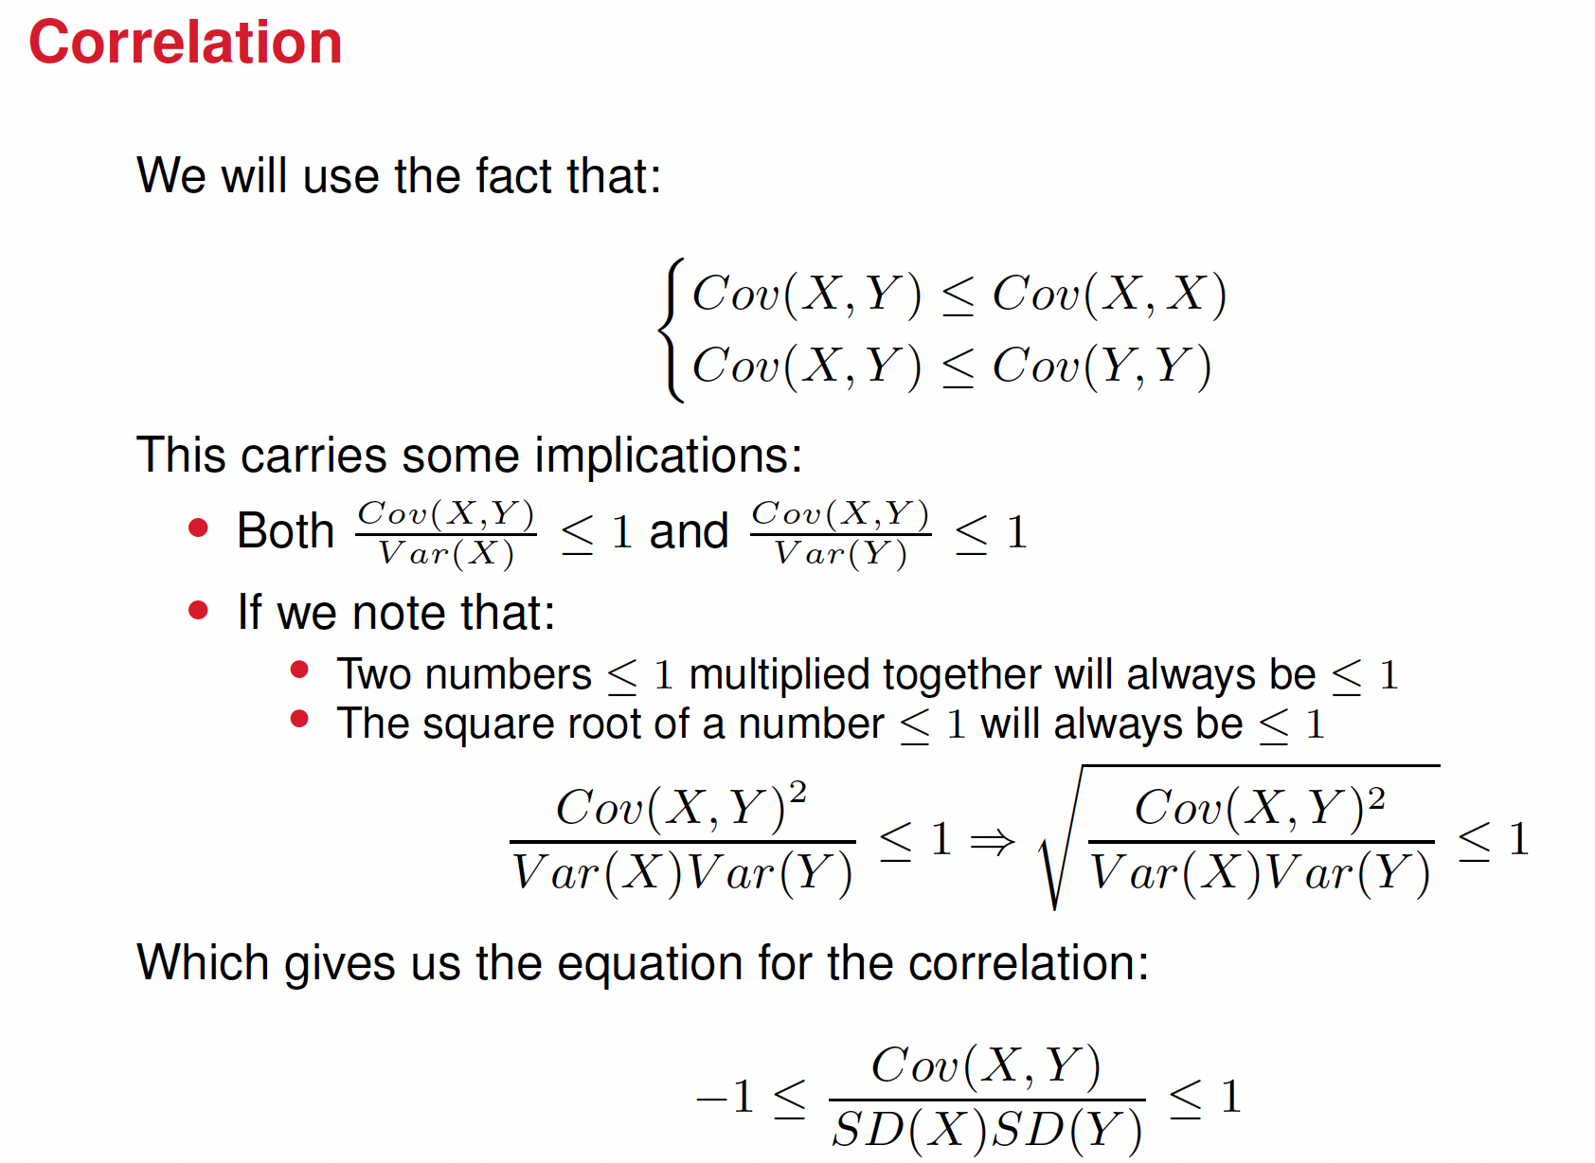



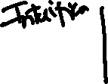

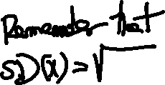





Notes:
Include the formula for the covariance. This formula is derived for explaining the -1, 1 limit but the formula is not there

Slide 18
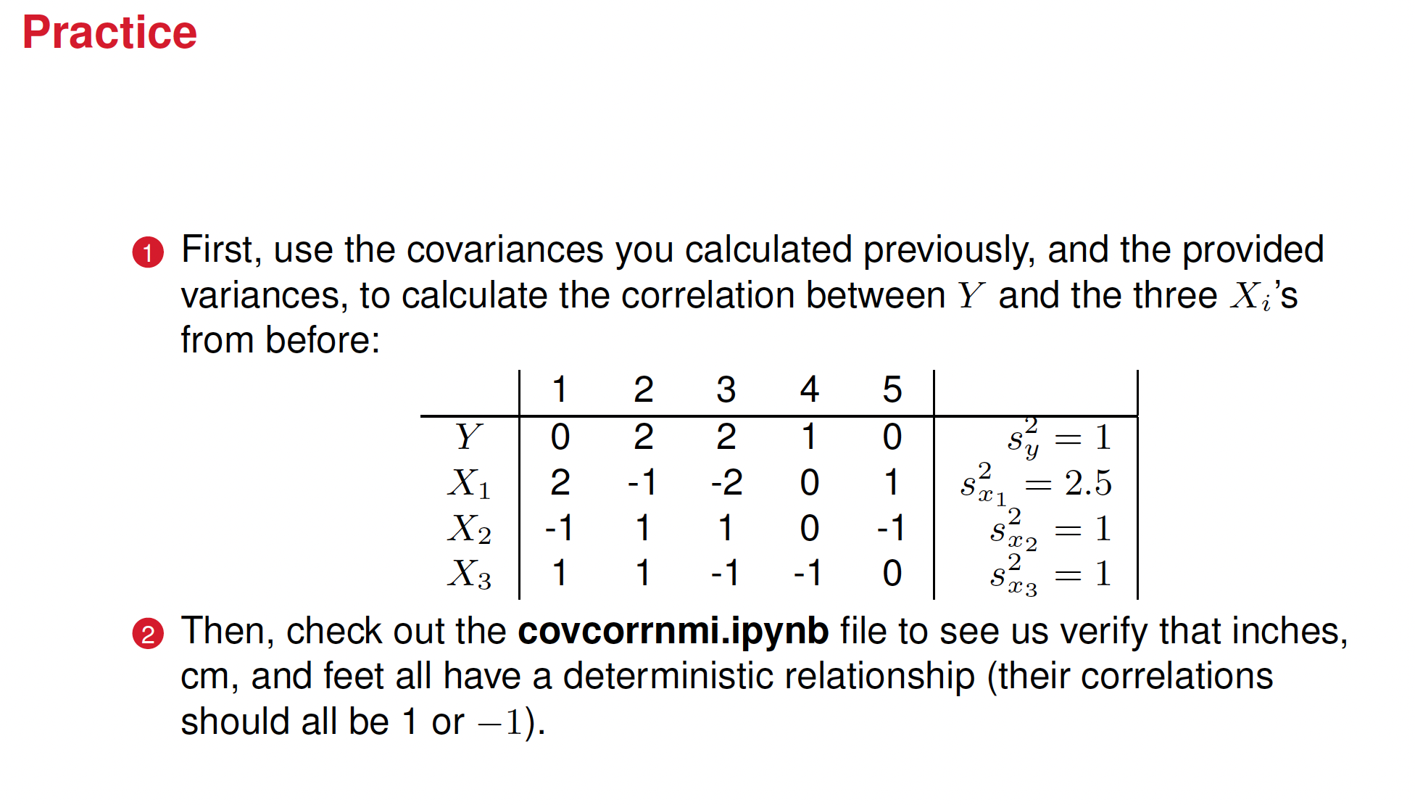

Slide 19
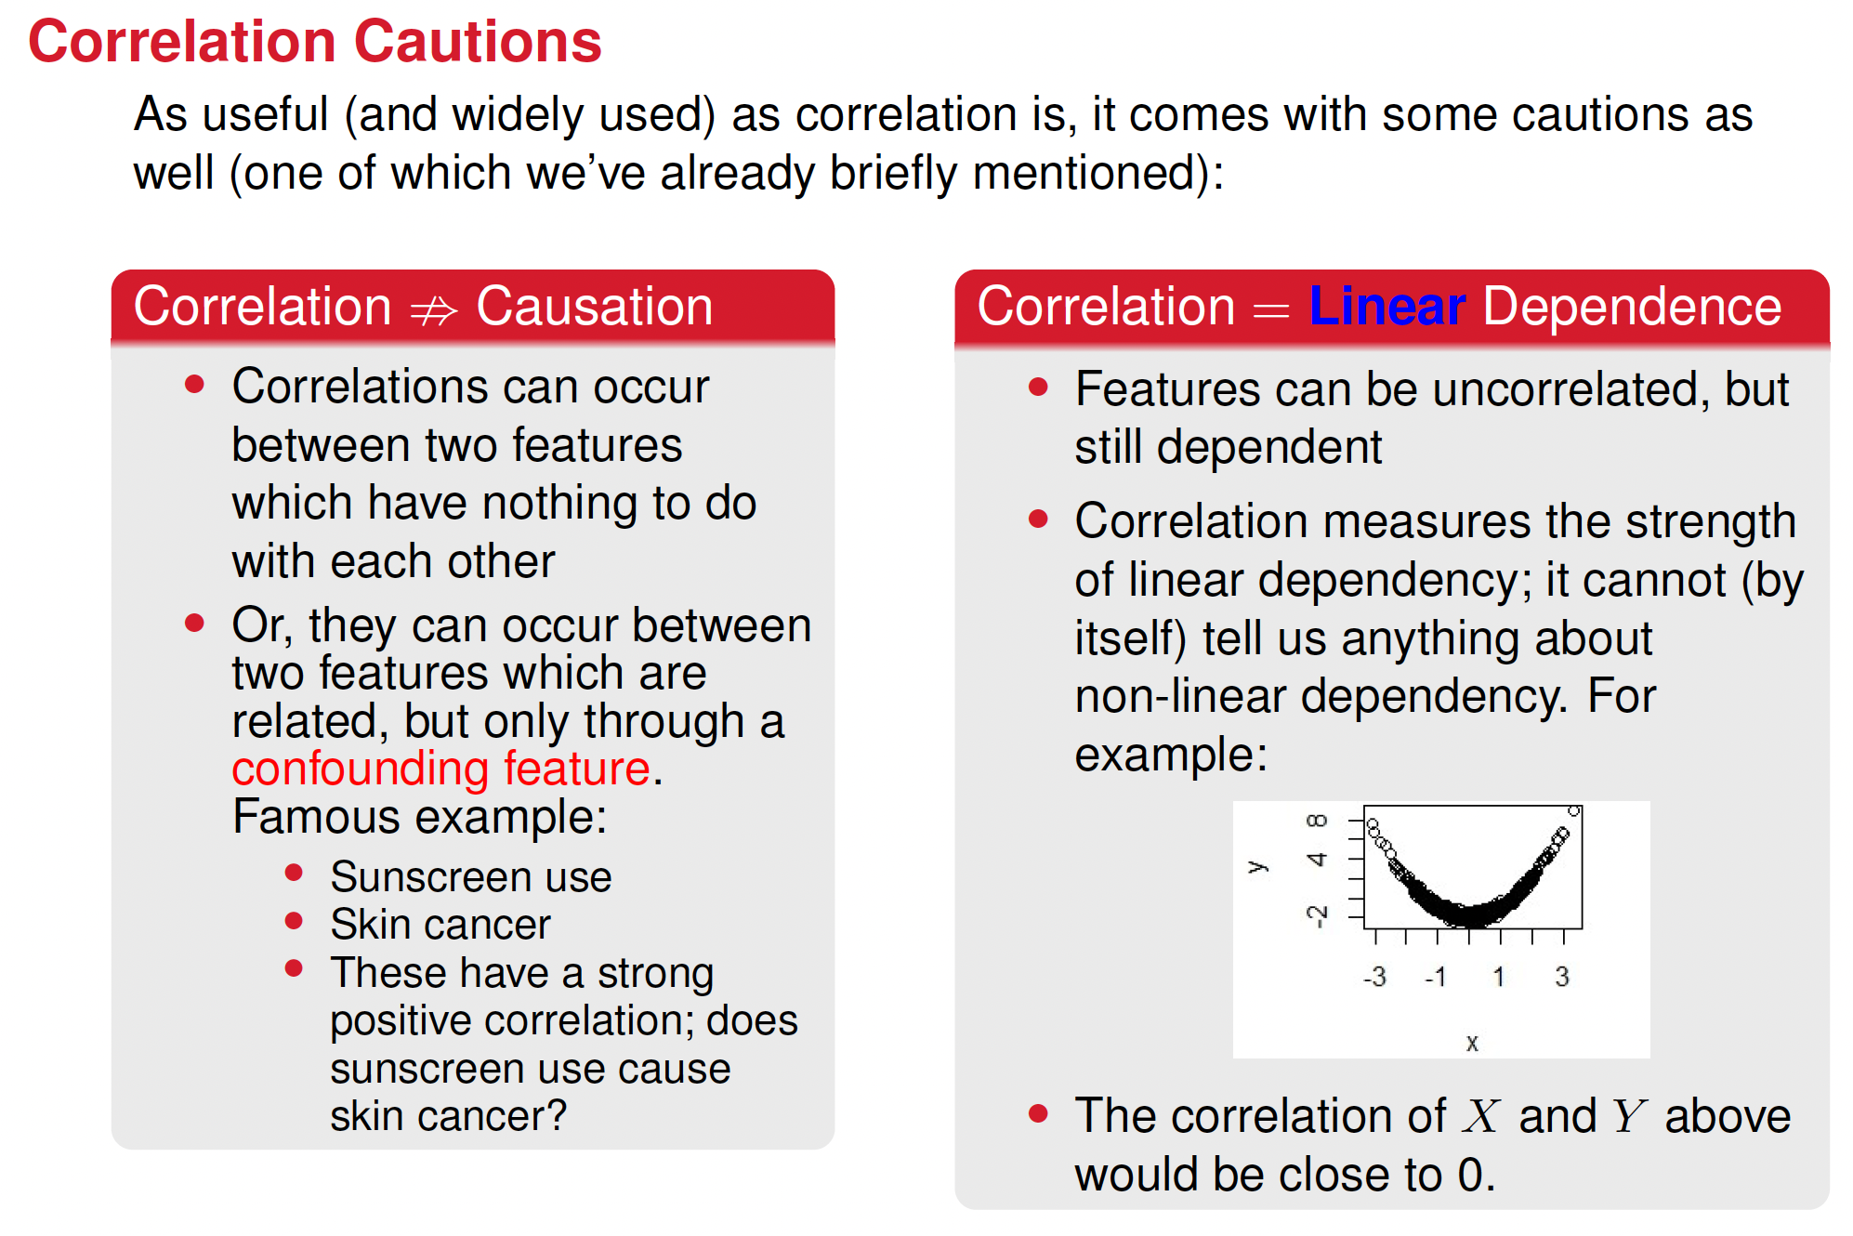







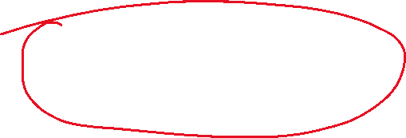

Slide 20
Mutual information
Mutual information can be used to study the non-linear dependence between two variables
We have already studied mutual information, but in the next slides we will review it

Slide 21
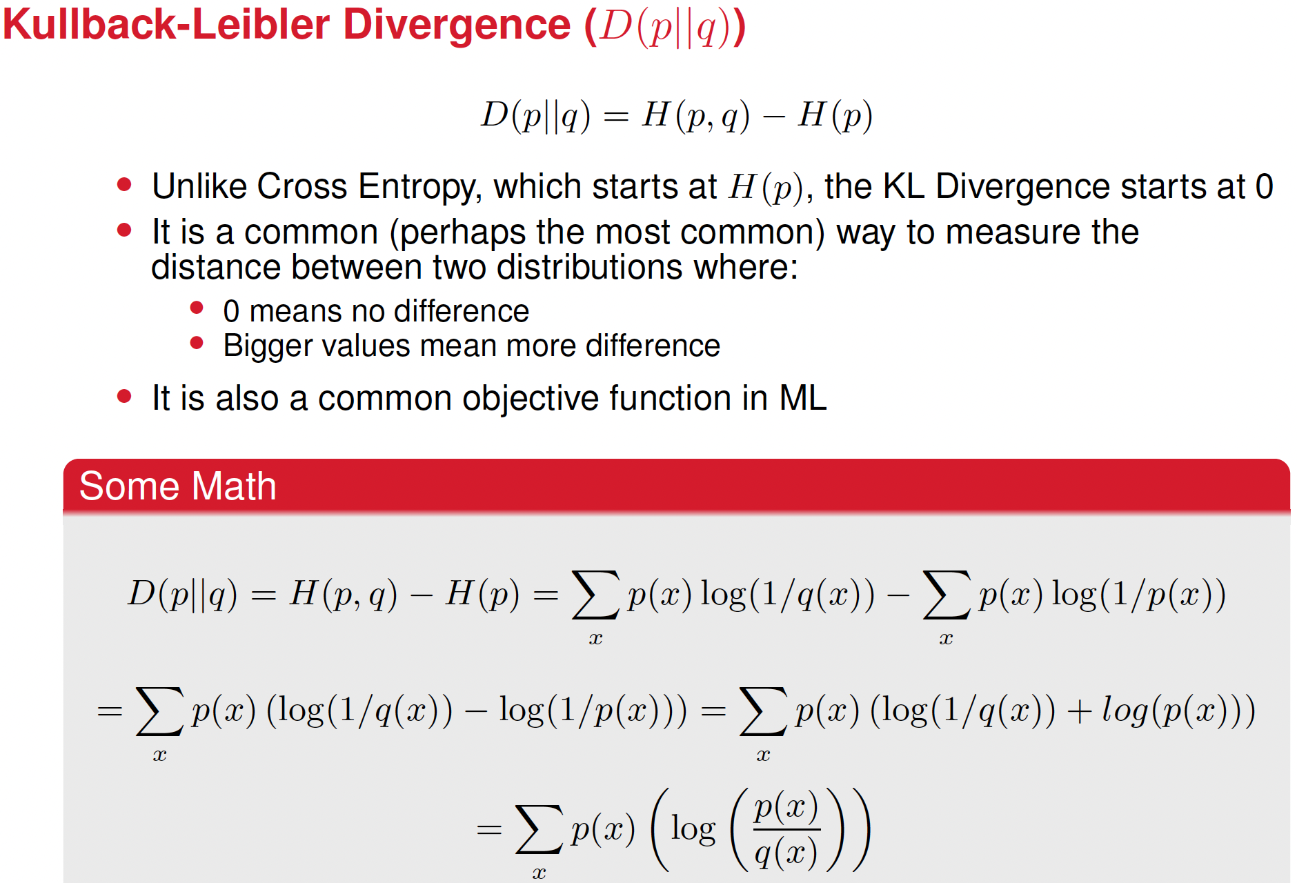

Slide 22
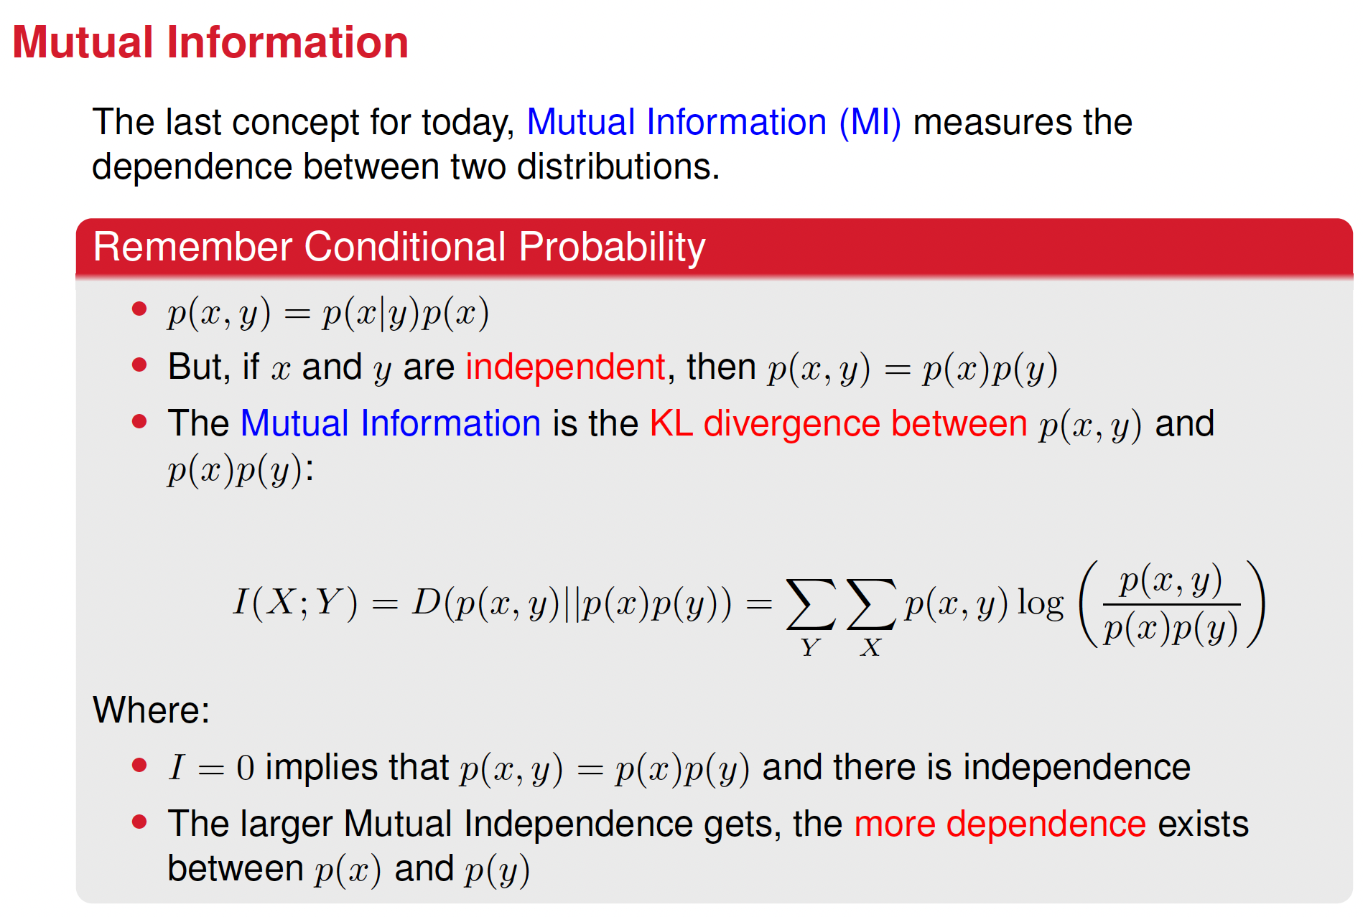

Slide 23
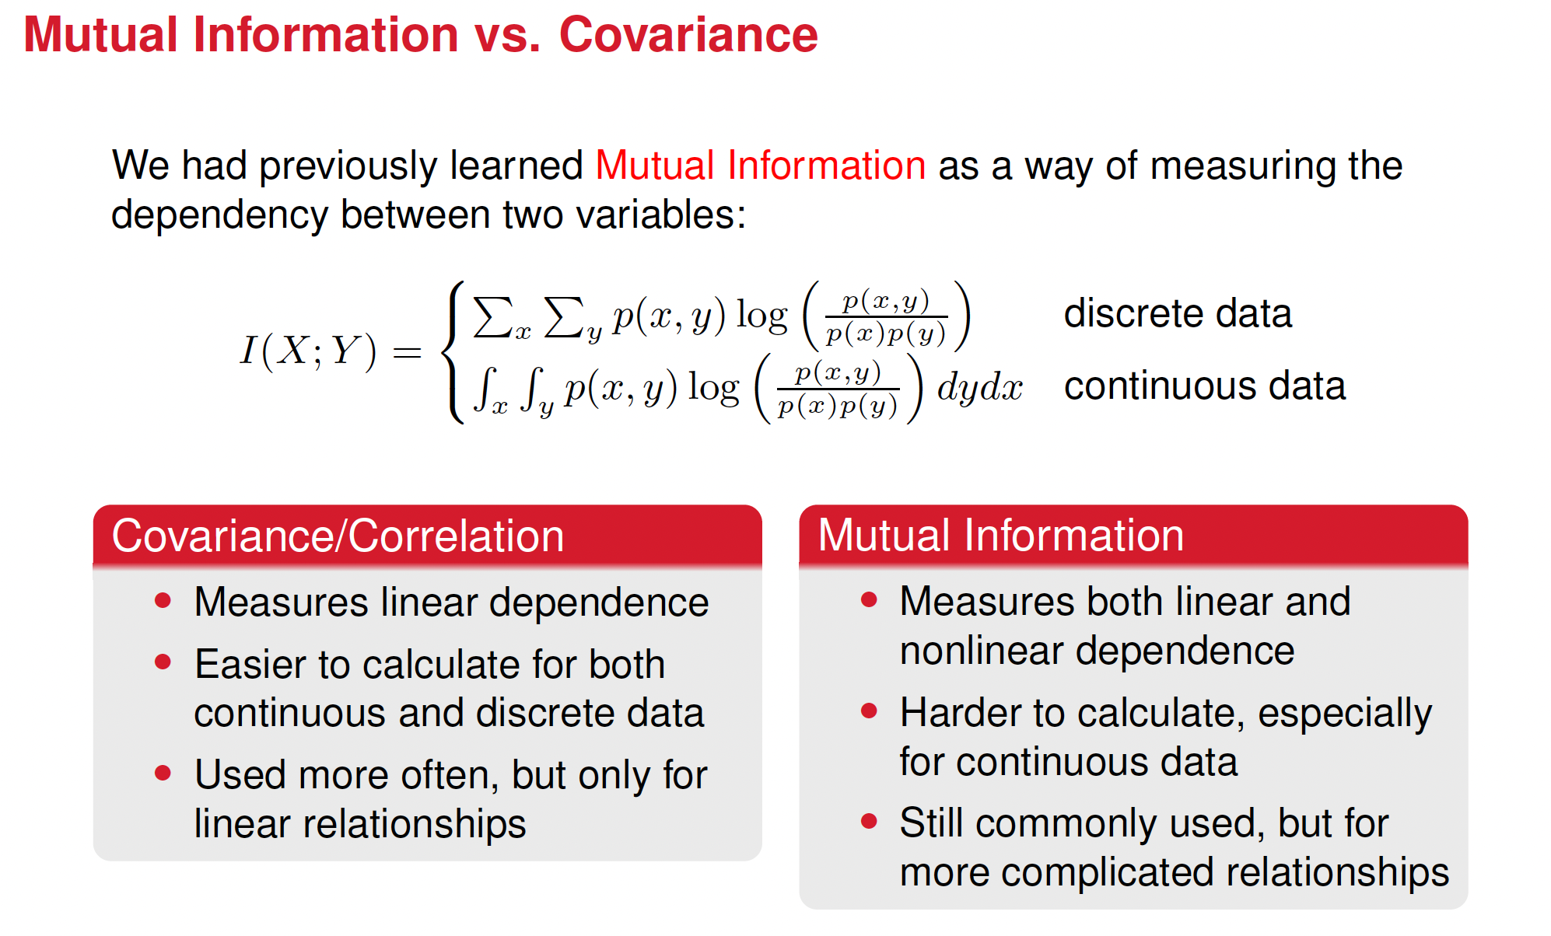
Notes:
Explain this better. Too light the concepts. Include here an slide on mutual information

Slide 24
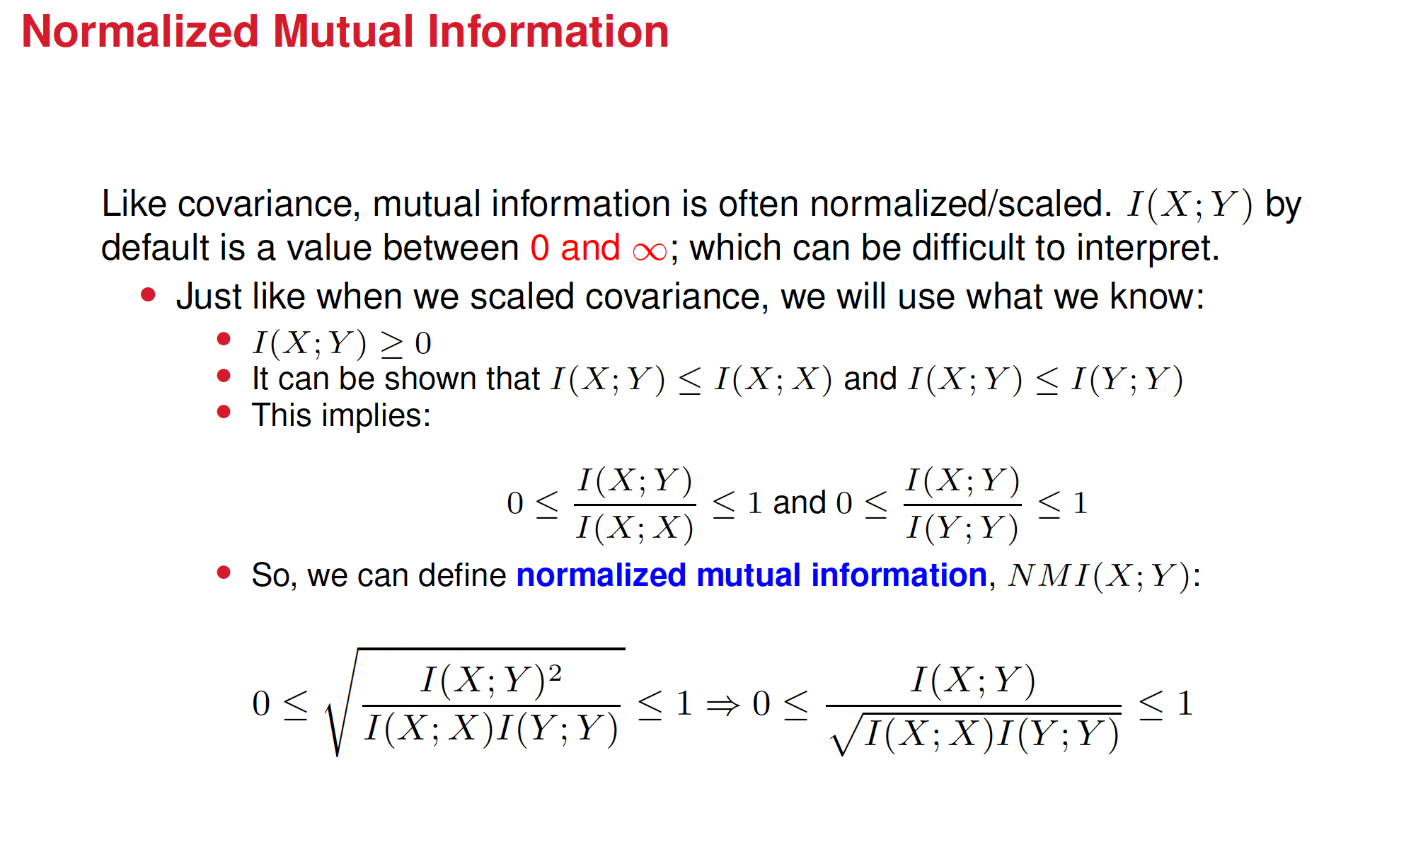
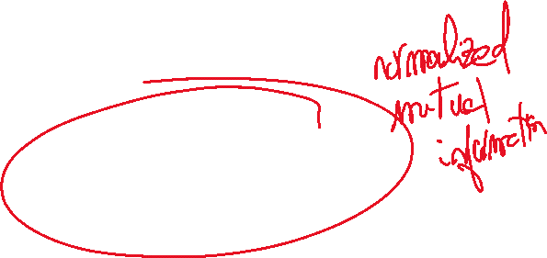

Slide 25
